Slide 1

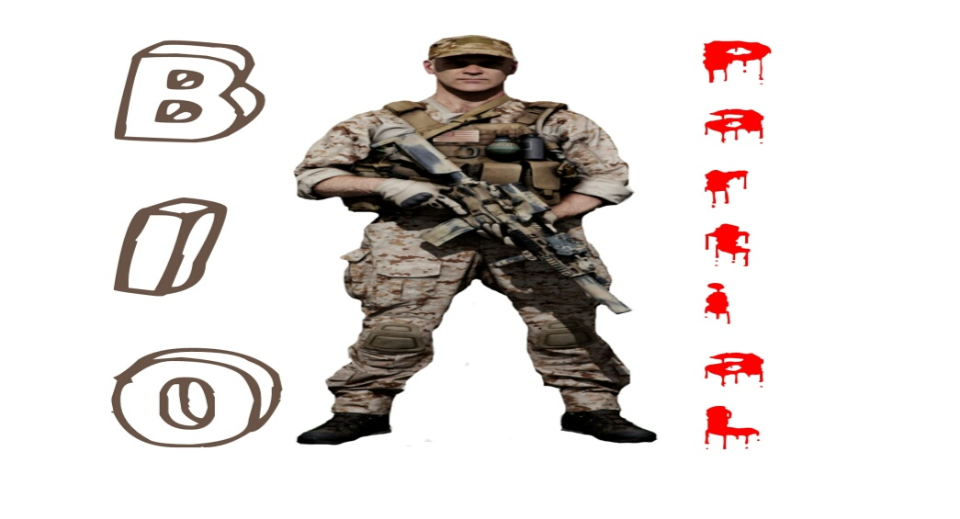

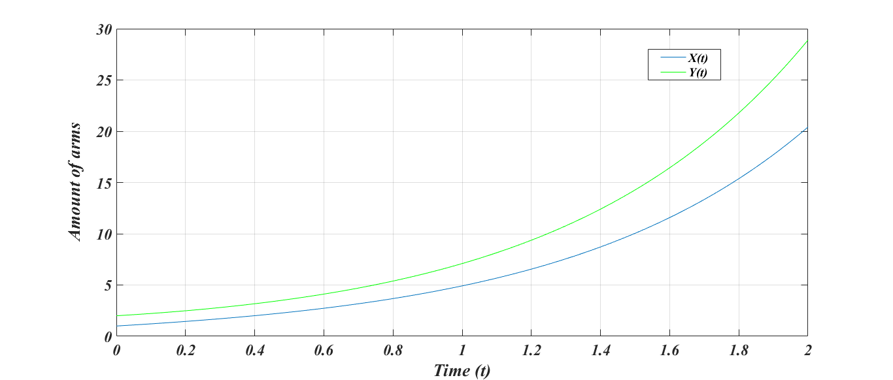
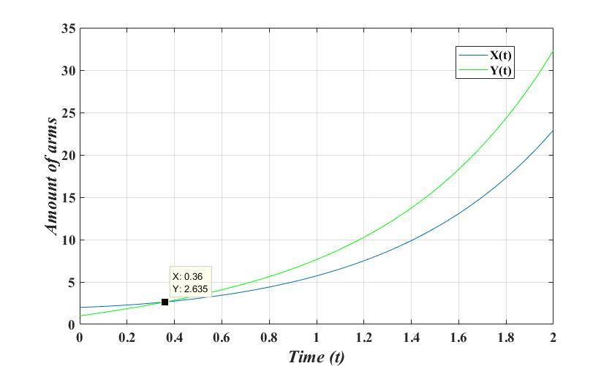
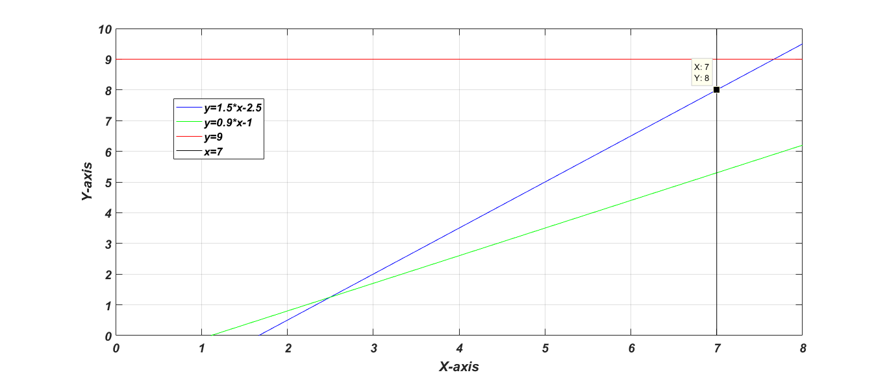
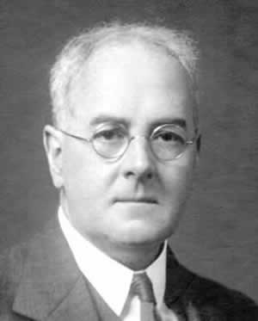


Cairo University
Faculty of Engineering
SBME Department
Course code : MTH124B
Course name : Differential Equations
Submitted to : Prof. Ahmed G.Radwan
ARMS
RACE
Bio Partial
Yassin Alaa
Yossef Sameh
Kirolos Dawood
Mohammed Almotasem
Abstract
Introduction
An arms race, in its original usage, is a competition between two or more states to have the best armed forces. Each party competes to produce more weapons, larger military, superior military technology, etc. in a technological escalation.
Back in the days of the cold war between the United States of America and the Soviet Union, the greatest interest was in the "ARM RACE" between the two countries. And since the end of the war, most of the scientists had focused on the regional antagonisms to analyze it.
Wars and conflicts are raging every day, and every country cares only about having stronger army, and to help analyzing the situation since world war II till now, many models have been invented. These models are depending many differential equations that uses the data in our world to achieve accurate results to understand and predict the state, and we hope in this humble report to illustrate the concept of an "Arms Race Model”.
Our Suggested Model
As long as arms race is an important topic we need to figure out a lot of theories to understand the whole topic which deals with the economic state, the variables the country needs to pay attention and how to calculate them in a scientific method not randomly, etc. which is the new model we formulated . The difference between Richardson’s model and this model is our model is mathematically complicated and appreciation of fundraising
Results
In the next figure we show the situation that resembles the competition between two countries and explains how an arms race between them is escalating by tending the functions to ∞.
The next figure is very important to determine when the system of equations will intersect or in other words at what time will the armory building up of the first nation will surpass that of the second nation.
The next figure is graphed to calculate the value of the equilibrium point to decide whether the system of the suggested model is stable or not
The problem with Richardson's Model:
In fact before the success of the model in the Indian-Pakistan case it unfortunately failed when it was applied to a conflict between Greece and Turkey . The problem with the model is that Richardson didn't take the budget constraint into consideration. Unfortunately, not considering the budget constraint as a parameter in the calculations causes a great divert in the results causing many errors.
Richardson model
An assumption used to describe the arms race . A model which is based basically on DE using common formulas taking in consideration the variables of arrangement , military , reads , etc.
Conclusion
As we reached the end of our report or we may say the end of our journey through these models that made a difference in the history course, we really have seen how Mathematics and it’s principles can introduce to us a group of differential equations that can help us to understand our political world better, we may also say from what we have learned that: This world is so cruel and have no mercy or pity in it, and despite that every country is inviting people to promote for world peace they really only care about being on the top of the others even if it means to consume all the income to go on an "Arms Race".

